Slide 1
Tableau : Assignment - I
Kisan pendharkar

Slide 2
What is tableau?
Tableau is a visual analytics platform.
It is easy, Powerful and fast and help in taking important business
decision.
We don’t need any prior coding skill or technical background in order to learn Tableau.

Slide 3
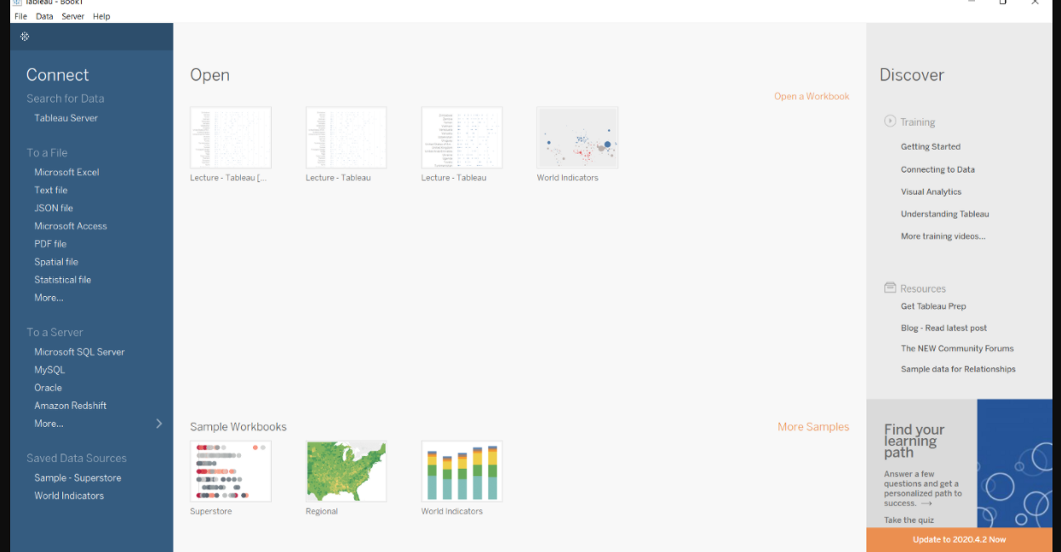
2. Explain several option of the start page of tableau desktop.

Slide 4
Start Page section consist of 3 sections:
1. Connect – Connect sections allows tableau to connect with desktop files(different file type) and different database type.
File type can be ms excel, pdf, csv, json, statistical file etc
2. Open - You can open your existing workbook or workbook in which you have work earlier.
By clicking on open you can access earlier version of workbook that you have created for visualization.
3. Discover – In the discover section, we get short tutorial provided by tableau community.
Important blogs or also some important work done by all contributor in tableau community

Slide 5
3. What is data visualization?
Data visualization is the graphical representation of information and data.
The row data transformed in charts, graphs, and maps, with using visualization tools

Slide 6
4. Explain all the steps of process flow of BI Project.
1. Business understanding:
The Business Understanding phase focuses on understanding the objectives and requirements of the project.
2. Data understanding:
In Data Understanding phase start with data collection and we understand data how is our data ?
3. Data Preparation:
The data preparation phase cover the many activities and construct the final data
4. Modeling:
Here we will build and assess various models based on several different modeling techniques.
5. Evaluation:
here chooses models that appear to have high quality and achieve the business objective.
6. deployment:
In this phase we reach on summary of the project ,which might include a final presentation and final results.

